Slide 1

Analysis

Slide 2
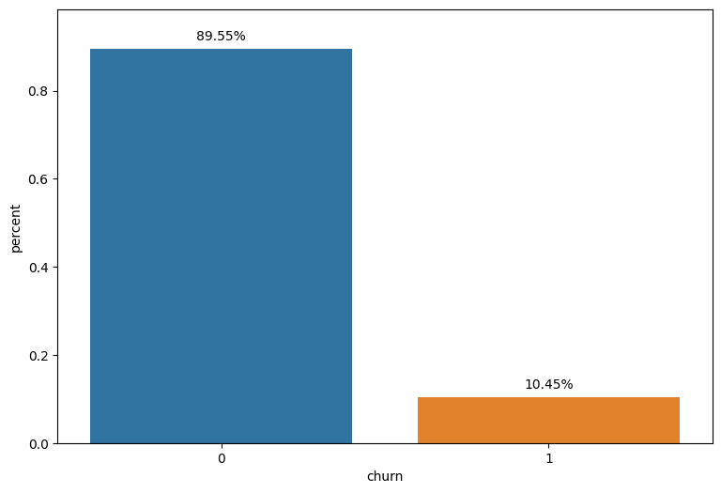
EDA Findings
1. Roughly 9.72% of customers opted to switch providers.
2. The numerical variables related to consumption exhibit significant skewness.
3. Alterations in prices show no discernible impact on customer churn.
1. When other providers offer significantly better deals than the current one, customers tend to switch, even if their current prices decrease.
2. Clarification is needed regarding zero values in the price data. If zero prices indicate free energy or power, understanding the rationale behind this is crucial.
3. Factors like customer satisfaction play a vital role. For instance, if providers maintain exceptional customer service, price increases might not necessarily cause customer churn.

Slide 3
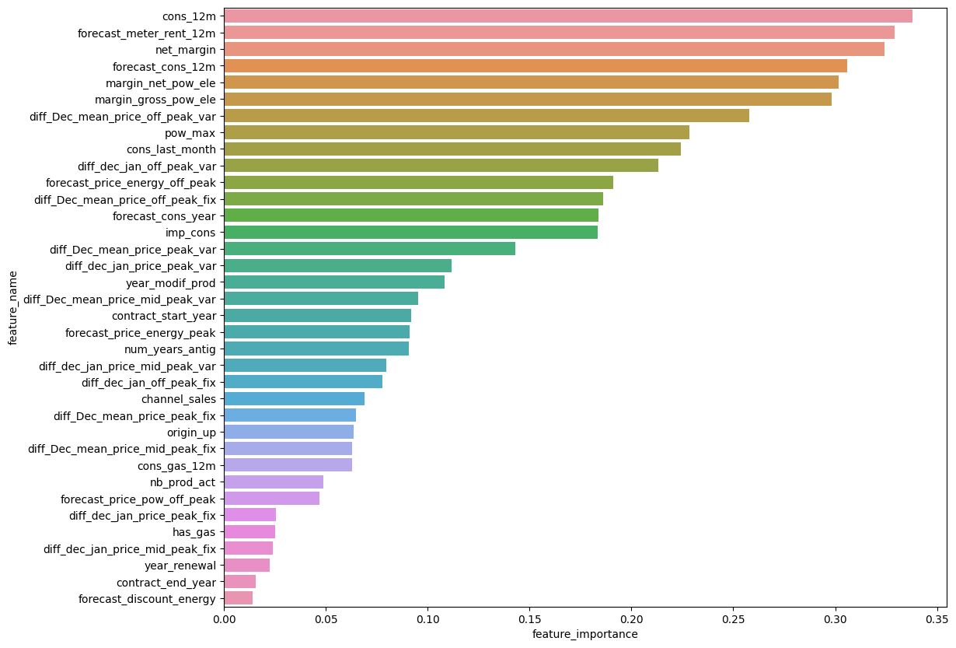
Predictive Findings
The obtained results reveal poor performance despite achieving a high accuracy of 90%. However, this accuracy is misleading and ineffective since the focus is primarily on accurately predicting the positive class rather than the negative class.
The model's capability to identify actual positive samples is merely 6%. Fortunately, within the predicted positive samples, a substantial 86% accurately represent real positive samples.
Discounted prices offered to 104 predicted churning customers resulted in a profit increase for 61 customers, leading to a total expected profit rise of $2,806,758.
Conversely, 43 customers experienced a decrease in expected profit, resulting in a total expected profit decline of $1,017,426.
Overall, offering discounts to the predicted churning customers is projected to generate an additional profit of $8,520,113.

